Slide 1
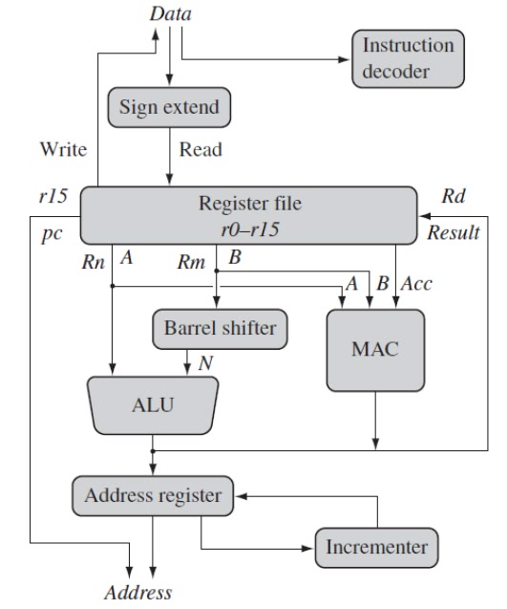
ARM CORE DATAFLOW MODEL

Slide 2
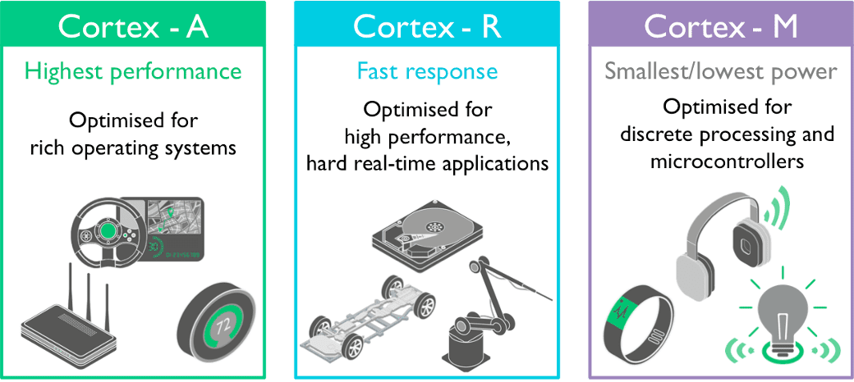
ARM CORTEX FAMILY

Slide 3
CORTEX-M APPLICATION AREAS
ARM CORTEX M
AUTOMOTIVE
IOT
HOME APPLIANCES
PC & MOBILE ACCESSORIES
TEST & MEASUREMENT DEVICES
MEDICAL INSTRUMENTS

Slide 4


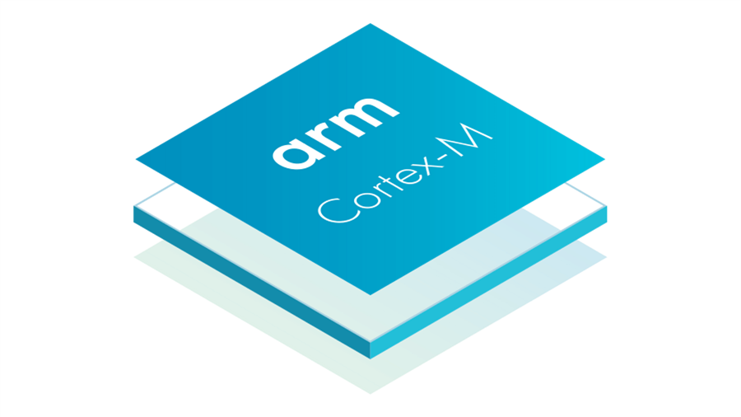




CORTEX-M BASED MCU MANUFACTURES
many more…

Slide 5
CORTEX-M4 OPERATING MODES
Thread mode
- Used to execute application software
- The processor enters Thread mode when it comes out of reset
Handler mode
- Used to handle exceptions/interrupts
- The processor returns to Thread mode when it has finished all exception processing
Unprivileged execution
- cannot access the system timer, NVIC, or system control block etc
Privileged execution
- The software can use all the instructions and has access to all resources

Slide 6
CORTEX-M4 OPERATING MODES
In Thread mode, the CONTROL register controls whether software execution is privileged or unprivileged
In Handler mode, software execution is always privileged
Only privileged software can write to the CONTROL register to change the privilege level for software execution in Thread mode

Slide 7
CORTEX-M4 Features
High performance Harvard architecture ,32-bit processor
3-stage pipeline
Thumb instruction set
Integrates a configurable Nested Vectored Interrupt Controller (NVIC)
Up to 240 interrupts
256 interrupt priority levels
Memory Protection Unit (Optional)
JTAG port & 2-pin Serial Wire Debug (SWD)
The system timer (SysTick)
Floating Point Unit (Only Cortex-M4F)

Slide 8
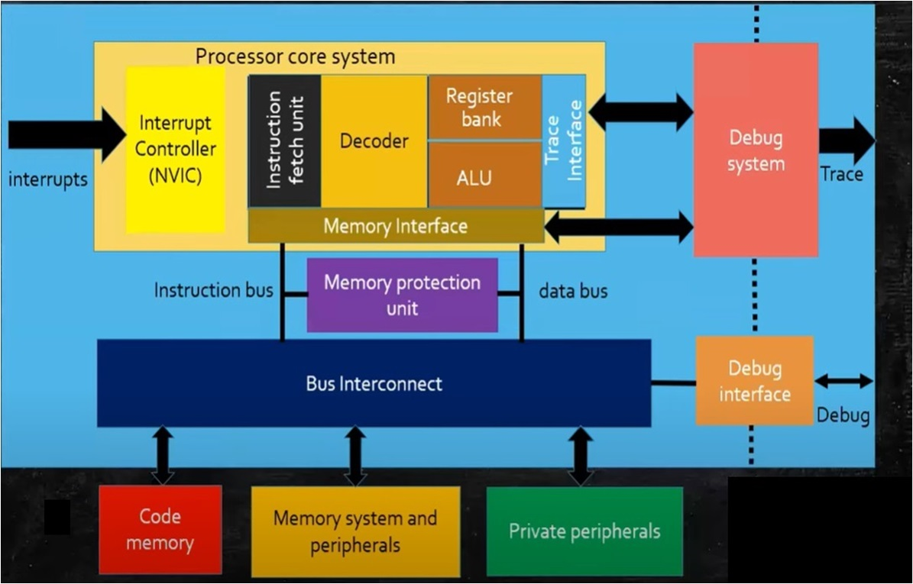
CORTEX-M4 Architecture

Slide 9
CORTEX-M4 Architecture
Nested Vectored Interrupt Controller
The NVIC supports
- An implementation-defined number of interrupts, in the range 1-240 interrupts.
- A programmable priority level of 0-255 for each interrupt.
- A higher level corresponds to a lower priority, so level 0 is the highest interrupt priority
Memory Protection Unit
The MPU divides the memory map into a number of regions, and defines the location, size,
Debug & Trace
Supports JTAG & SWD which allows break-points, watch-points etc
access permissions, and memory attributes of each region

Slide 10
CORTEX-M4 Architecture
Bus Interconnect
- connects the processor & debug interface to external buses
- The main bus interfaces are
- code memory bus (I-code & D-code)
provides access to code memory
- System bus
provides access to SRAM, Peripherals, ext RAM etc
- Private peripheral bus
provides access to NVIC,MPU,SCS,debugging & trace unit

